Slide 1

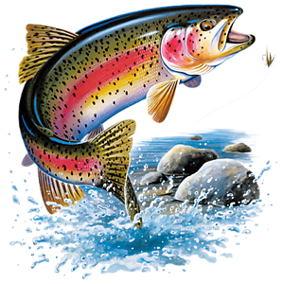
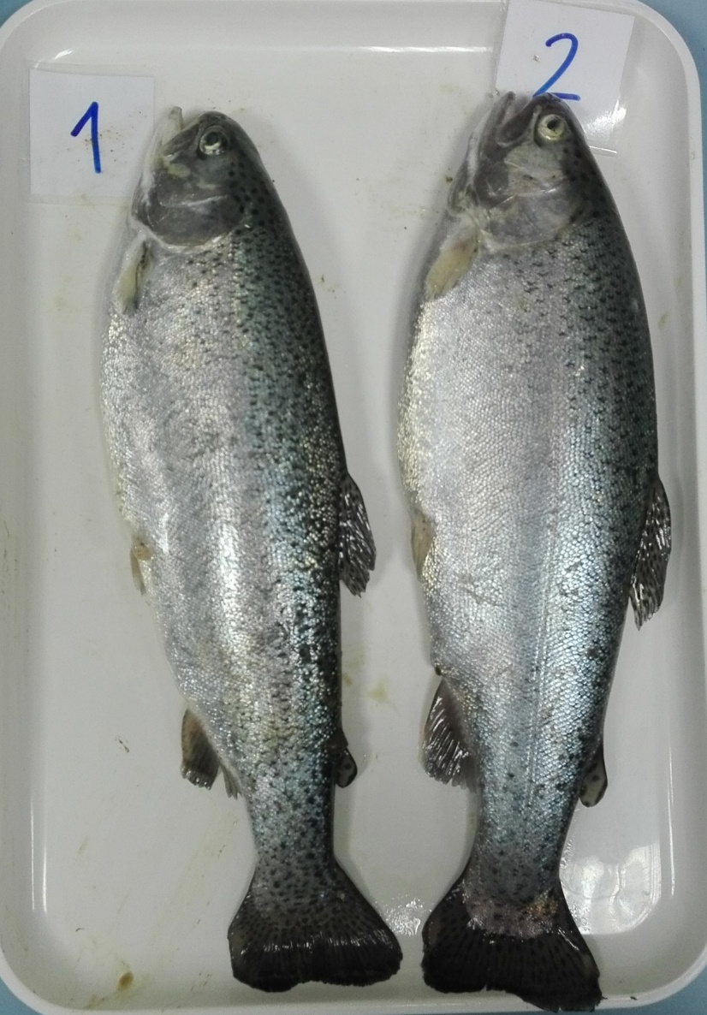
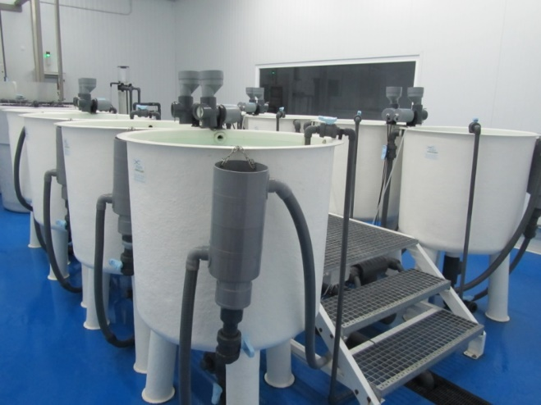









Insects are a good protein alternative for fish food, but Spanish citizens have prejudices
Insectmeal in aquafeeds:
consumers perception
RESULTS (Sensorial analysis)
Sensorial perception in raw fish...
Melenchón F.¹, Larrán A.M.¹, de Mercado E.¹, Sanz Calvo M.A.¹, Tomás-Almenar C.¹, Cardenete G.², Fabrikov D.³
1 Agro-Technological Institute of Castilla y León (ITACyL)
2 Zoology Department, University of Granada
3 Biology and Geology Department, University of Almería
Sensorial analysis (raw, 1st trial) | CONTROL | H15 | H30 | T15 | T30 | SEM
Acceptability | 2.28 | 2.91 | 2.52 | 2.68 | 2.43 | 0.25
Colour | 3.1 | 3.42 | 3.99 | 3.8 | 3.94 | 0.26
Texture | 1.52 | 1.57 | 2.23 | 1.91 | 1.36 | 0.29
Odour | 1.96 | 2.7 | 2.96 | 2.51 | 2.93 | 0.25
QIm | 2.89 | 2.22 | 2.83 | 3.22 | 2.94 | 0.29
More than 5 yearly million tons of fishmeal are being extracted from the sea to feed aquaculture fish (FAO, 2020)
Sensorial analysis (raw, 2nd trial) | CONTROL | H30 | H50 | Hm50 | T50 | SEM
Acceptability | 3.00 | 3.37 | 2.78 | 3.39 | 3.08 | 0.46
Colour | 4.76^{ab} | 5.38ª | 3.65^{b} | 5.77ª | 4.78^{ab} | 0.34
Texture | 2.18 | 2.58 | 2.53 | 2.28 | 2.27 | 0.45
Odour | 2.43 | 2.56 | 2.73 | 2.74 | 2.18 | 0.41
QIm | 5.00 | 3.93 | 5.93 | 4.02 | 3.79 | 0.60
WE NEED ALTERNATIVE
PROTEIN SOURCES IN AQUACULTURE
- Two different insects tested as feed for different
life stages of rainbow trout
- Only a small difference in colour between
“traditional” and insect-fed rainbow trout
- Insects almost do not interfere
with consumers perception!
-Panellists did not highlight
any differences.
INSECTS are sustainable and have shown good performances, both in fish growth and as functional ingredients by enhancing the antioxidant system. However, they seem to worsen the ω-3 fatty acid profile of the fillet, which could be fixed through different strategies. In other words… they need more research, but they LOOK PROMISING!
Qim ➔ Quality Index method; Diets explained in methods section;
SEM➔ Standard Error of the Mean
The highest inclusion of Hermetia illucens (18% in feed), decreased the colour intensity of raw fillet.
Sensorial perception after cooking…
WHAT IS THE PERCEPTION OF THE CONSUMERS?
- Surveys reveal a
quite strong rejection
towards insect-fed fish
- When asked why, reasons
tend to diverge (some cannot
even give a real reason!)
- Sensorial analyses do not agree with survey…
Are we facing cultural prejudices? It is all
in the mind of the consumer!
Sensorial analysis (cooked, 3rd trial) | CONTROL | T50 | SEM
General Appearance
Brightness | 9.04 | 9.03 | 0.24
Exudate colour | 7.48 | 7.53 | 0.67
Colour intensity | 7.22 | 6.99 | 0.57
Colour uniformity | 7.84 | 7.86 | 0.33
Odour intensity | 6.58 | 5.74 | 0.49
Taste
Sweet | 2.37 | 1.46 | 0.46
Salty | 1.95 | 2.05 | 0.56
Bitter | 0.6 | 1.26 | 0.40
Sour | 0.37 | 0.44 | 0.18
Texture
Hardness | 2.72 | 2.41 | 0.56
Juiciness | 5.46 | 4.79 | 0.53
Fatty | 2.49 | 3.49 | 0.65
Gumminess | 4.18 | 3.24 | 0.63
Teeth adherence | 3.79 | 3.16 | 0.62
Flavour
Rancid | 1.33 | 1.29 | 0.43
Vegetable | 1.53 | 0.91 | 0.33
Earthy | 3.41 | 3.58 | 0.66
Sea | 2.98 | 2.78 | 0.59
Fatty sensation | 1.86 | 2.24 | 0.52
CONSUMER
PERCEPTION
SENSORIAL ANALYSIS
OPINION
SURVEY
Raw fish
Fillet
Whole fish
Cooked fillets (trained panellists)
METHODS – sensorial analyses(*)
3 Experiments on rainbow trout; 3 Growth trials
(up to 140, 90, and 415 g respectively; different diets, 4 replica)
1st: control + 2 HI diets + 2 TM diets
2nd: control + 3 HI diets + 1 TM diet
3rd: control +
TM diet
Recirculating system
T. 13-15 °C
Ox. 8-10 ppm
12:12 h L/D
Sensorial analysis in cooked fillet of 3rd trial
Diets explained in methods section; SEM➔ Standard Error of the Mean
Sensorial analysis
in raw fish
The panellist did not notice any significant changes in fish fed the highest inclusion of Tenebrio molitor (18% in feed, 50% fishmeal replacement).
* HI ➔ Black soldier fly (Hermetia illucens)
TM ➔ Mealworm (Tenebrio molitor)
-1st trial: 15% (H15, T15) and 30% (H30, T30) fishmeal replacement with both
insectmeals.
-2nd trial: 30% (H30) and 50% (H50) fishmeal replacement with HI (one of them,
omega-3 enriched, Hm50) + 50% fishmeal replacement with TM (T50)
-3rd trial: 50% fishmeal replacement with TM (T50)
Attributes measured for both raw and cooked fish analyses described in results.
Sensorial analyses in raw fish based on a modified version of QI method
(Bremner, 1985).
Discussion
Our results match the current bibliography, since it has already been described that insect-based diets can lead to changes in fish fillet colour (Iaconisi 2017; Iaconisi 2018). However, the work of Borgogno (2016) described small changes in several attributes such as tenderness and metallic flavour when using higher inclusion levels of HI, which means that more research is needed in this topic.
Talking about the survey, the results were kind of expected due to cultural reasons. Bazoche (2020) described that some factors such as neophobia, personal information concerning environmental consciousness, or even gender, can influence these opinions. In this way, education and consciousness raising about environmental sustainability could help on the topic of introducing insects as a viable protein alternative for fish.
RESULTS (Survey)
.
METHODS – survey
References
Bremner, H. A. 1985. A Convenient, Easy-to-Use System for Estimating the Quality of Chilled Seafood. Fish Process. Bull., 7: 59-70.
Borgogno M. et al. 2016. Inclusion of Hermetia illucens larvae meal on rainbow trout (Oncorhynchus mykiss) feed: effect on sensory profile according to static and dynamic evaluations. J. Sci. Food Agric., 97: 3402-3411.
Iaconisi V. et al. 2017. Dietary inclusion of Tenebrio molitor larvae meal: Effects on growth performance and final quality treats of blackspot sea bream (Pagellus bogaraveo). Aquaculture, 476: 49-58.
Iaconisi V. et al. 2018. Mealworm as dietary protein source for rainbow trout: Body and fillet quality traits. Aquaculture, 484: 197-204.
Bazoche P., Poret S. 2020. Acceptability of insects in animal feed: A survey of French consumers. J Consumer Behav., 1–20
FAO. 2020. The state of world fisheries and aquaculture, sustainability in action.
Meanwhile…
Personal opinion on insect-fed aquaculture fish
But… why??
There are cultural motives and prejudices.
Survey: 70 potential Spanish consumers
Give a reason!
Would you…?
Funded with European and Spanish funds; acknowledgements to INIA, FEDER
(Ref. RTA 2015-00021-C03), FSE and AEI (Ref. BES2017-080567)

